Slide 1
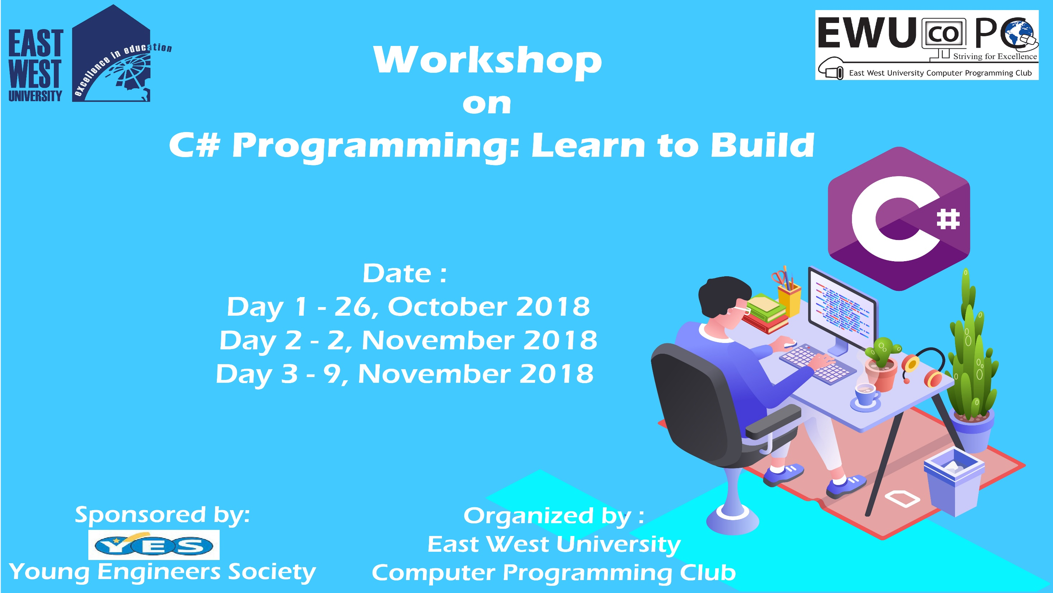

Slide 2
C# Day 2 Lecture8: Method

Slide 3
Method
Types of method call:-
call by value
call by reference(keyword ref)
call by output (keyword out)
call by params (keyword params)

Slide 4
Method
public static int callByValue(int a ,int b)
{
int c = a + b;
a = 200;
return c;
}
static void Main()
{
int a = 10;
Console.WriteLine(callByValue(a,20));
Console.WriteLine(a);
}

Slide 5
Method
public static int callByRef(ref int x)
{
x = 100;
}
static void Main()
{
int value = 10;
callByRef(ref value);
Console.WriteLine(value);
}

Slide 6
Method
public static void callByOut(out int a, out int b)
{
a = 10;
b = 20;
}
static void Main()
{
int outVar1;
int outVar2;
callByOut(out outVar1, out outVar2);
Console.WriteLine("call by out " +outVar1+" " +outVar2);
}

Slide 7
Method
public static int callByParams(int a, params int[] ar1)
{
int x = a;
foreach (int b in ar1)
{
x += b;
}
return x;
}
static void Main()
{
Console.WriteLine(callByParams(10));
Console.WriteLine(callByParams(10,20));
Console.WriteLine(callByParams(10,20,30));
}

Slide 8
Method
public static int area(int height, int width=10)
{
return height * width;
}
static void Main()
{
Console.WriteLine(area(width: 20,height: 30));
Console.ReadKey();
}

Slide 9
Method
public static int area(int height, int width=10)
{
return height * width;
}
static void Main()
{
Console.WriteLine(area(height: 20));
Console.ReadKey();
}

Slide 10
This slide is provided as a course material in the workshop named “Workshop on C# Programming: Learn to Build”.
Organized by-
East West University Computer Programming Club (EWUCoPC)
Prepared by- Jannat Binta Alam
Campus Ambassador
Young Engineers Society (YES)
E-mail: jannat.cse.ewu@gmail.com

